Slide 1

CAFE MANAGEMENT SYSTEM
GAYATHRI DEVI P M (RA2311026020004)
GIRIJESH S (RA2311026020008)
RAMA MK (RA2311026020014)
RESHWANTH S (RA2311026020035)

Slide 2

Abstract
The Cafe Management System is a console-driven Java application backed by MySQL that replaces handwritten tickets and scattered spreadsheets with a single, menu-driven workflow. It covers the essential operational domains of a small café which includes customers, products, orders, billing, and reporting The purpose is to provide a predictable, low-cost alternative to paper processes that can run on shared café or lab laptops without additional licenses or specialized hardware.
-
01

Slide 3
Problem
Statement
Small and medium-sized cafés often rely on manual methods like handwritten order slips and spreadsheets, which are time-consuming, error-prone, and hard to scale, leading to inaccurate billing, misplaced orders, poor inventory tracking, and delayed reporting. While commercial point-of-sale systems offer advanced features, they are expensive and difficult to customize, making them unsuitable for small businesses. The Cafe Management System provides a cost-effective, database-driven solution that automates core café operations, improves accuracy and efficiency, and supports future enhancements such as graphical interfaces, analytics, and payment integration.
-
02

Slide 4

By replacing manual record keeping and spreadsheet-based tracking, the system minimizes human errors, speeds up daily tasks, improves inventory visibility, and enhances overall service efficiency. The solution is cost-effective, requires minimal hardware and training, and is designed to support future enhancements such as graphical user interfaces, advanced analytics, payment gateway integration, and multi-branch support.
Proposed Solution
The proposed solution is a console-based Cafe Management System developed using Java and MySQL that automates essential café operations including customer management, product cataloguing, order processing, billing, and basic reporting through a unified, menu-driven interface. The system follows a layered architecture that separates user interaction, business logic, and database access, ensuring better maintainability, reliability, and scalability. JDBC is used to enable secure and efficient communication with the MySQL database, while prepared statements and transaction handling maintain data integrity and prevent inconsistencies during order and billing operations.
03

Slide 5
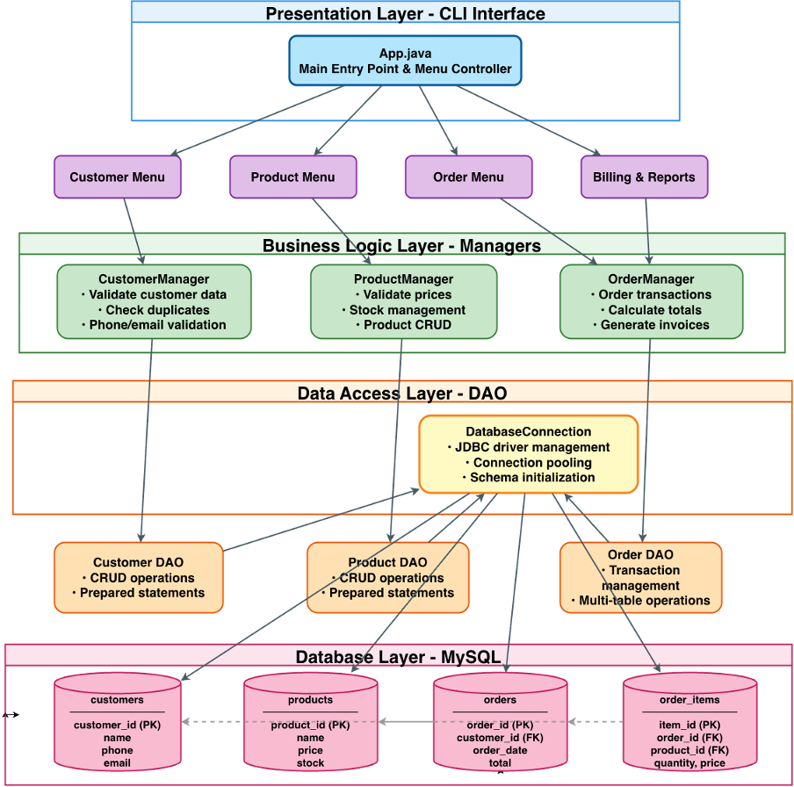
Block Diagram
-
04

Slide 6
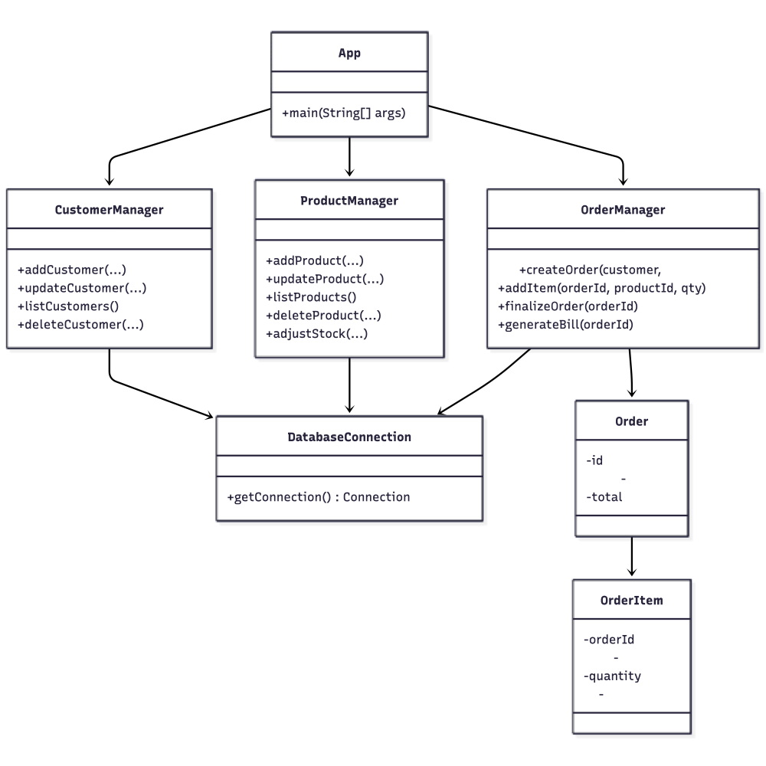
ER Diagram
-
05

Slide 7
06
The Cafe Management System uses a clean three-layer architecture that keeps code organized and easy to maintain. At the top, the CLI presentation layer displays menus and captures user input through simple prompts. Below that, the business logic layer contains manager classes that enforce rules like "prices must be positive" and "orders need at least one item." At the bottom, the data access layer uses DAOs with prepared statements to safely communicate with MySQL.
This separation means changes in one layer don't break others,you can modify menu text without touching database code, or adjust validation rules without rewriting SQL queries. The database schema connects four tables: customers store contact details, products hold items and prices, orders track transactions, and order_items link products to specific orders. Foreign keys maintain relationships, so every order item points to a valid product and every order can reference a customer. Indexes on frequently searched fields keep lookups fast even as data grows.
System Design

Slide 8
Tech Stack
Programming Language: Java 17
Database: MySQL 8.0
Connectivity: JDBC (Java Database Connectivity)
Build & Dependency Management: Maven
Development Environment: Visual Studio Code
Version Control: Git
07

Slide 9
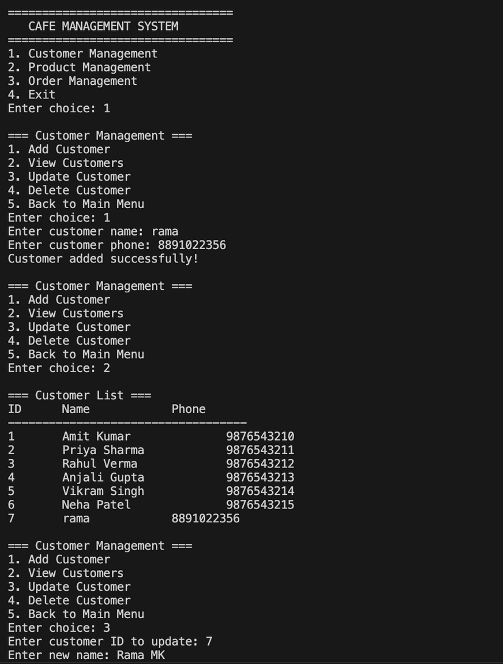
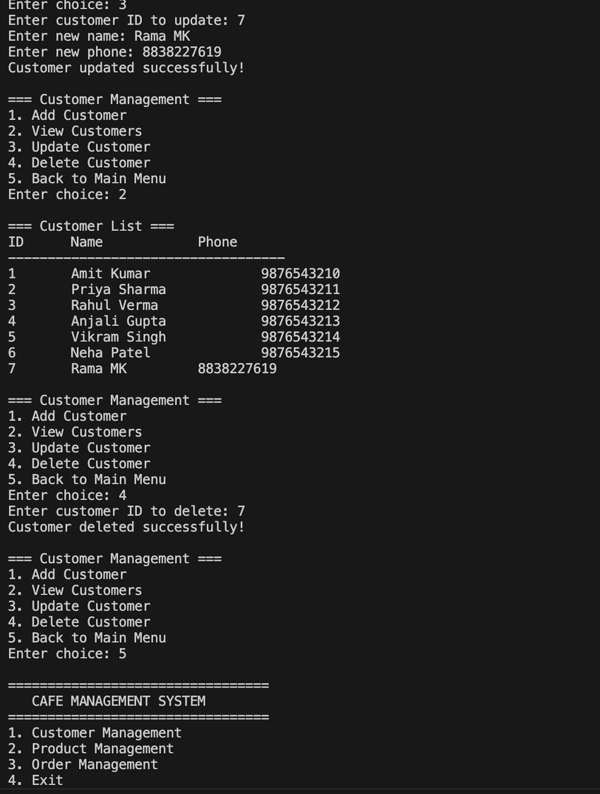
08
Results & Output

Slide 10
Conclusion and Future Enhancement
In the future, the system can be enhanced by introducing a graphical or web-based user interface for better usability, integrating secure payment gateways and customer loyalty programs, incorporating machine learning-based analytics for demand forecasting and sales insights, and extending support for multi-outlet café management to enable scalability.
The Cafe Management System successfully transforms traditional manual café operations into a well-structured and fully automated process, improving accuracy, efficiency, and reliability. The project demonstrates the effective application of software engineering principles such as modular design, layered architecture, and proper database management using Java and MySQL. By organizing customer, product, and order data in a centralized system, the application reduces human errors and speeds up daily operations.
09

